Slide 1
Week 5 - Forms
CPAN 212 – Modern Web Technologies
Professor: Harman Mann

Slide 2
Agenda
Form Data
Sending files – using Multer (new module)
Form Validation
This will be information dense

Slide 3
So, Middleware in express
Middleware in Express refers to functions that can execute in the ‘middle’ of a request/response cycle typically before a matching route function is executed.
Middleware functions are functions that have access to the request object (req), the response object (res), and the next() function in the application’s request-response cycle.
The next() function is a function in the Express router which, when invoked, executes the middleware succeeding the current middleware

Slide 4
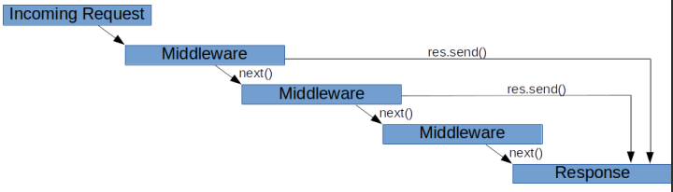
Middleware Order is Important
When a request is received by Express, each middleware that matches the request is run in the order it is initialized until there is a terminating action (like a response being sent)

Slide 5
Let's try making some middleware
Let's try making a quick little logger function
When someone hits a request
Write the route, the method and the time they tried to access the endpoint
This will go back to making our own module and how we can use it in express

Slide 6
Logger function inside 1 route
Moving into Code, Screenshots will be on the end of

Slide 7
Moving onto the next topic: Async and Await
The idea is simply
I will start doing this
You continue handling another operation
IRL i.e: I will start the lecture while doing attendance
I will pass the operation onto you while I go through the lecture, making attendance asynchronous
In our class:
Our server needs to be able to handle multiple interactions
Sending webpages, parsing data, confirming logins, checking databases
We don’t want to bottleneck our operations from those operations taking time

Slide 8
Callbacks
Functions are executed in the sequence they are called. Not in the sequence they are defined
Callbacks give us greater control over the sequence of execution
Very useful in asynchronous functions
Fundamental component of JavaScript
Do not use parentheses when passing callback

Slide 9
A big part of having a server
Handling incoming data
Processing data
Creating/ storing information in our database
So how do we do that
-> Recall anything from your React Class?
Maybe something like fetch, and a method: POST

Slide 10
The TLDR
Remember the req object
It takes in params and query -> which is URL based
How do we send FORM data?
Google it -> (something like: “html form to node”)
i.e of result: node.js - Submit html form to nodejs - Stack Overflow
Express Tutorial Part 6: Working with forms - Learn web development | MDN (mozilla.org)

Slide 11
What’s important here
The extension we added: urlencoded
It allows us to send over form data and have it broken down and understood by our server
(I showcased a login example)

Slide 12
Processing Forms in Express
Create a form in HTML (or a form in React)
Set an action to send it through URL and with POST as the method (same for React)
Choose the correct enctype for sending it to the server
Server side:
In the server: Apply some middleware to parse the enctype and the form datas
Do whatever you need from there (validate, save to DB etc)

Slide 13
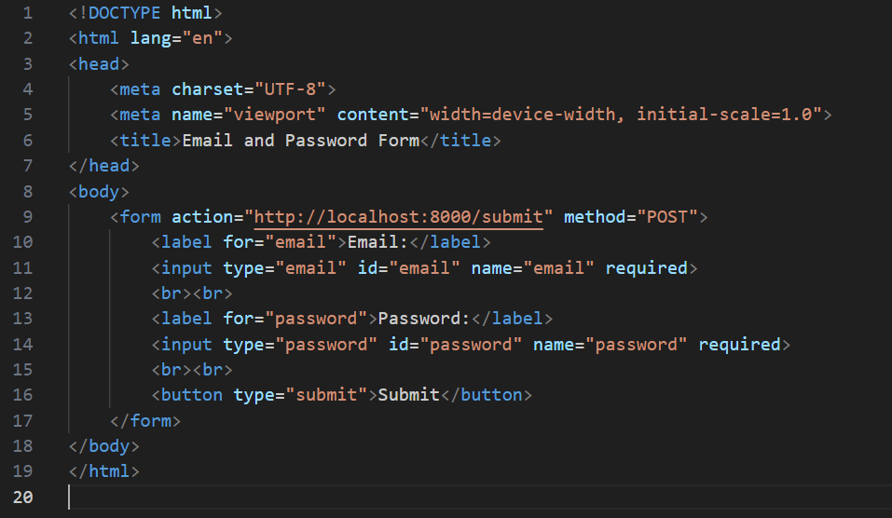
Client-side code
For class: we will send this from our server through a get method and receive the request with the post method – how do we do that

Slide 14
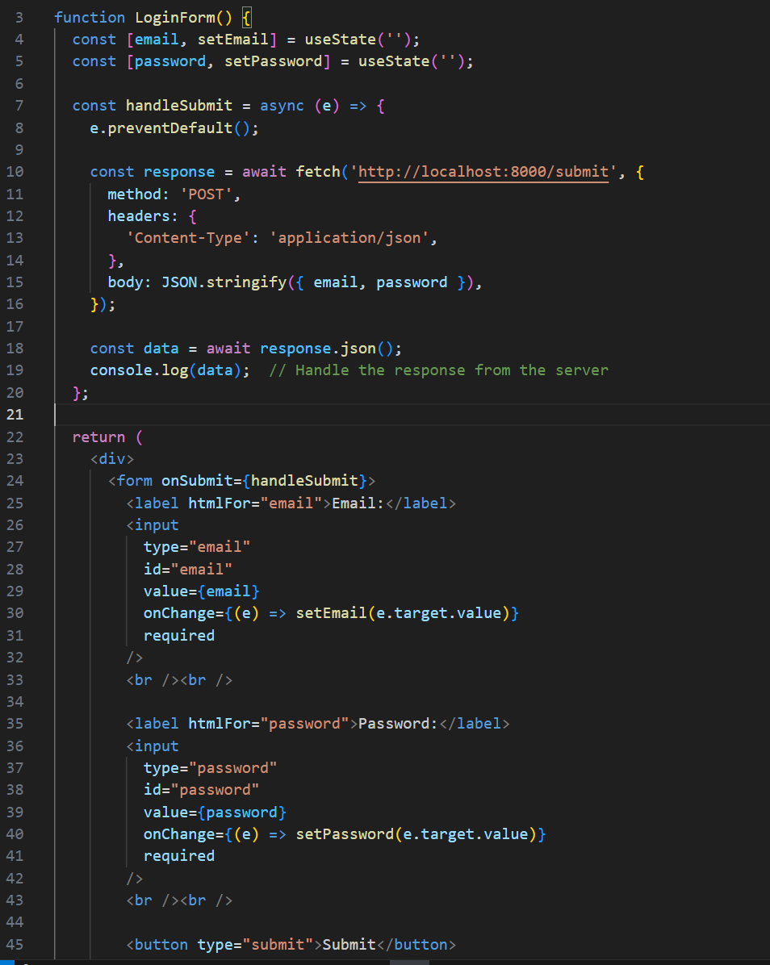
Client-side code - React

Slide 15
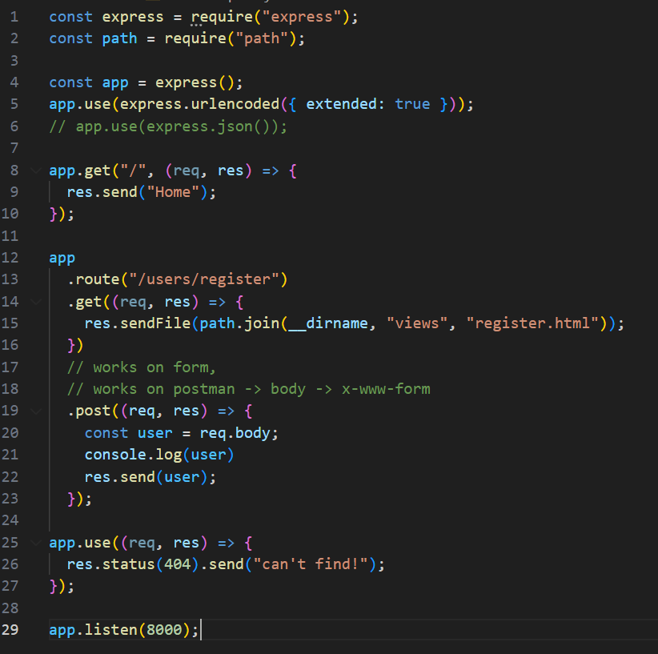
Server-side code

Slide 16
Some demo

Slide 17
Next topic: What about file uploads?
Lets setup a form to send over a file through the HTML form
What do we notice

Slide 18
Well, what happened to the file?
The file isn’t transferred because of the enctype of the form we are submitting.
The default type is meant to send basic information, text
We need to change the type to something that can handle text and files
Its called multipart

Slide 19
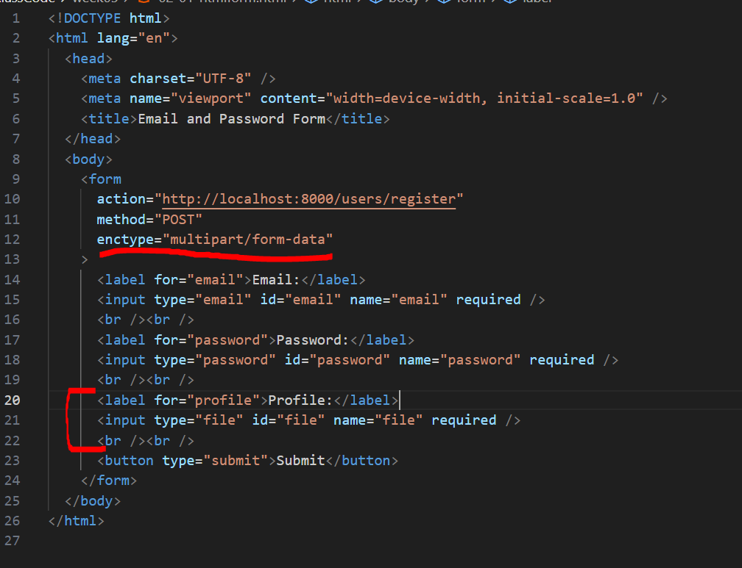

Slide 20
In our class session we will use: Multer
I say that because there are different ways to establish file uploading, this is the most traditional way
multer - npm (npmjs.com)
Let's explore the web link and implement it
You want something beyond Multer, here this will be on your personal time:
Phase 1: How to Upload Files in Node.js Using Express and Multer - YouTube
Phase 2: I Found a BETTER Way to Do File Uploads (youtube.com)

Slide 21
Multer
Multer is a node. js middleware for handling multipart/form-data , which is primarily used for uploading files
https://github.com/expressjs/multer
The multer library is only needed when you are dealing with file uploads and multipart/form-data. If you are simply using text form data you can use the built in “express.urlencoded” middleware to handle regular text submissions and access the data on req.body

Slide 22
Installing the module
In your terminal: npm install multer
Add multer into your express file:
const multer = require(“multer”)

Slide 23
We need to define a location to store files
const storage = multer.diskStorage({
destination: function (req, file, callback) {
callback(null, "uploads/");
},
filename: function (req, file, callback) {
callback(null, file.originalname);
},
});
const upload = multer({ storage: storage });

Slide 24
Example route:
app
.route("/upload")
.get((req, res) => {
res.sendFile(path.join(__dirname, "views", "upload.html"));
})
.post(upload.single("file"), (req, res) => {
console.log(req.file); // Information about the uploaded file
res.send("File uploaded successfully");
});
More information on functions with multer: Express multer middleware (expressjs.com)

Slide 25
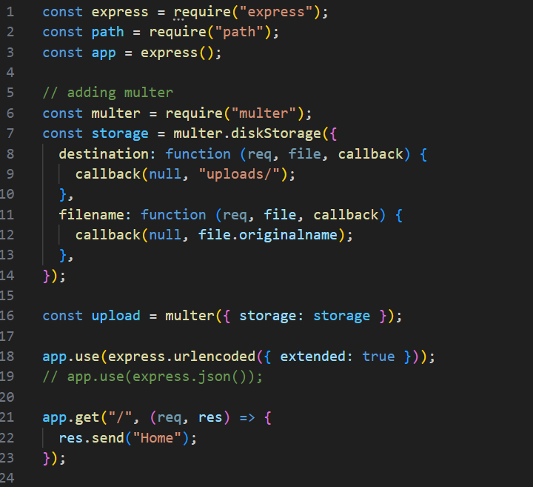
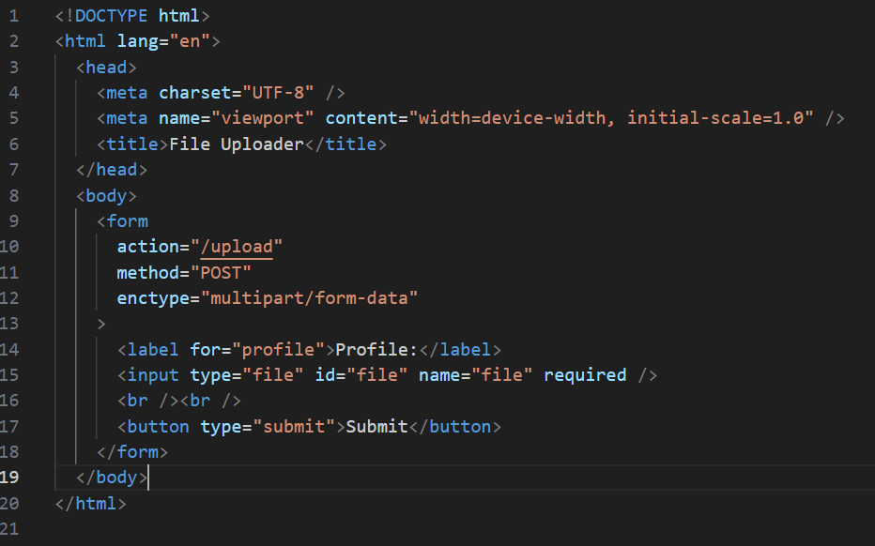
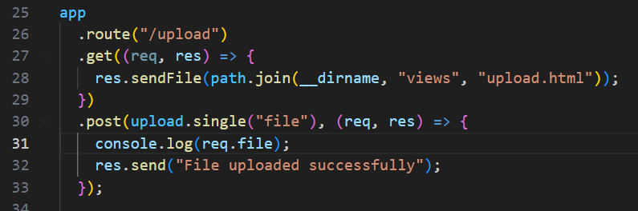
Implementation here

Slide 26
ENCTYPE attribute
The enctype attribute specifies how form-data should be encoded before sending it to the server (this goes into your html code)
Enctype=“multipart/form-data”
Used for sending files or form-data objects.
Multer is a node.js middleware for handling multipart/formdata, which is primarily used for uploading files.
application/x-www-form-urlencoded
To handle a text-only multipart form, you should use the multer().none() method:

Slide 27
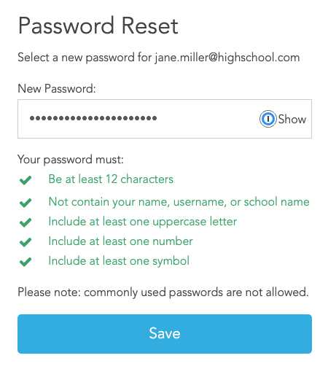
Next Topic: Form Validation

Slide 28
Form Validation
Anytime you have a client-side form that send back data and/or file contents, you should always validate both client side AND server side
For example, it is important to validate the form on the client side so you can create a better user experience and inform the user if something is missing or a wrong filetype is provided right away.
If a field is missing or an incorrect data type is provided, you can let the user know before you submit the form and wipe out the user’s progress.
In you react class, did you check the information BEFORE sending it?
We also need to check it in the server

Slide 29
Form Validation
On the server side it is even more important to validate everything the client has sent.
A malicious user can use a command line utility like URL to make Api requests to your server and send anything they want, even if your client-side code validates the data before it’s sent.
Another method is to use the developer tools in the browser to remove the client-side validation and then submit anything to your server.
Therefore, it is extremely important to validate data on the server side before working with it - especially in a production environment

Slide 30
Form validation in Express
express-validator is a set of express.js middlewares that wraps validator.js validator and sanitizer functions
Install it using npm:
npm install --save express-validator
Let’s take a look to this :
https://express-validator.github.io/docs/

Slide 31
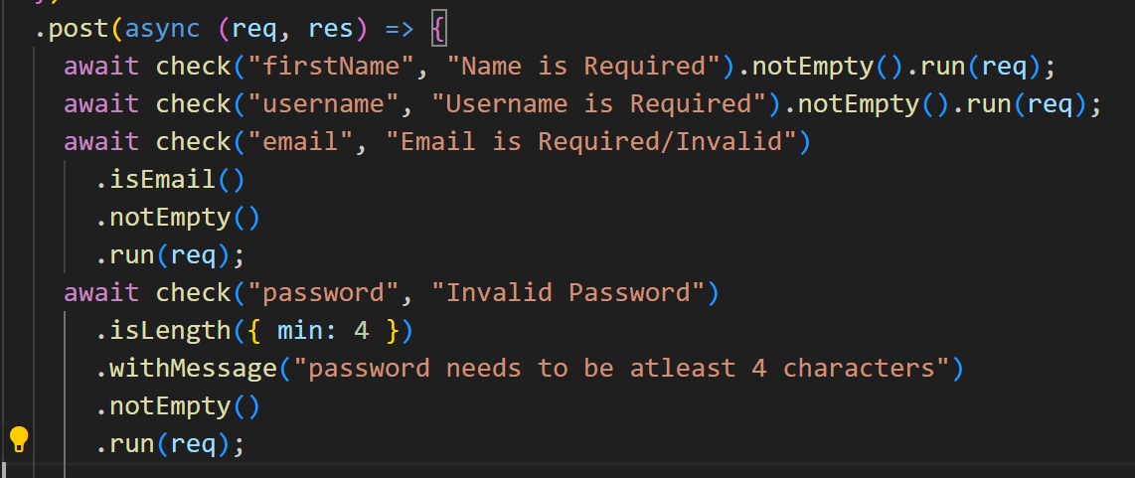
Another example: Version 1 Part 1

Slide 32
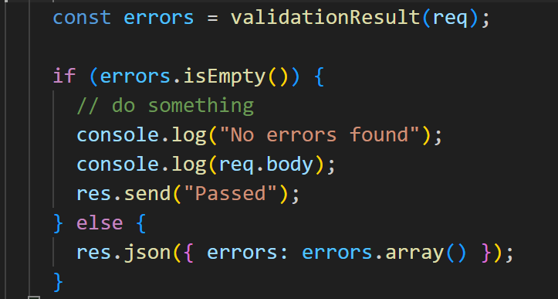
Another example: Version 1 Part 2

Slide 33
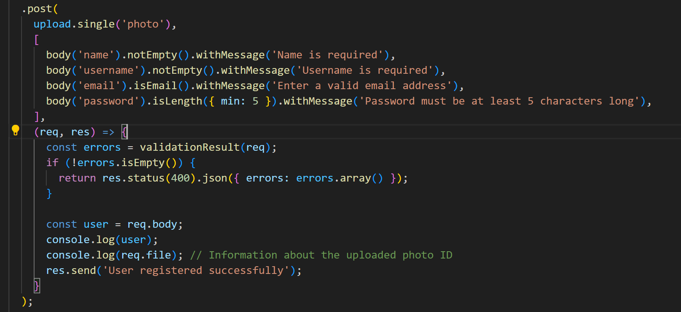
Another example: Version 2

Slide 34
Sanitizing inputs
While the user can no longer send empty person names, it can still inject HTML into your page! This is known as the Cross-Site Scripting vulnerability (XSS).
express-validator helps us to use a sanitizer
it transforms special HTML characters with others that can be represented as text, using “escape()”
app.get('/hello', query('person').notEmpty().escape(), (req, res) =>.

Slide 35
That’s it for today
Your lab has been posted

